Slide 1
PIXNET Hackthon
問: 為何如此美味好吃， 讓我坐下蒲團也要把持不住， 顏面多有損失!!
GAN: 因為所有留白， 都已填滿YUMMY色彩！何不速速跳牆過來？
Team: MY_SK_ll

Slide 2

MY_SK_ll ....who we are
Larry, LKK
Mickey
Larry, Young
Yvong
Katy
Schwartz

Slide 3
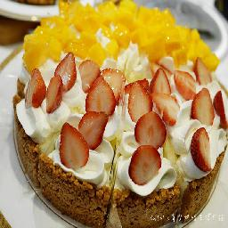
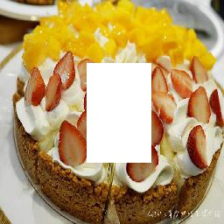

The Problem
What to fill?

Slide 4
First thing first..Cleaning

Slide 5
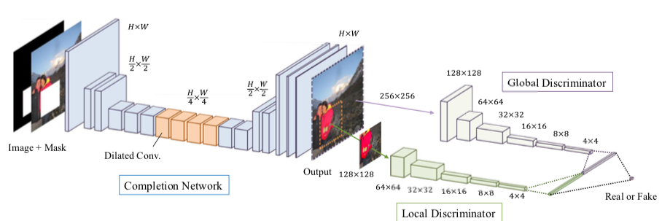
Base Network
GLCIC
Dilated Convolution, Global Discriminator,
Local Discriminator

Slide 6
Issues
What are the issues of Base Model?
Need to Add Attention Mechanism

Slide 7
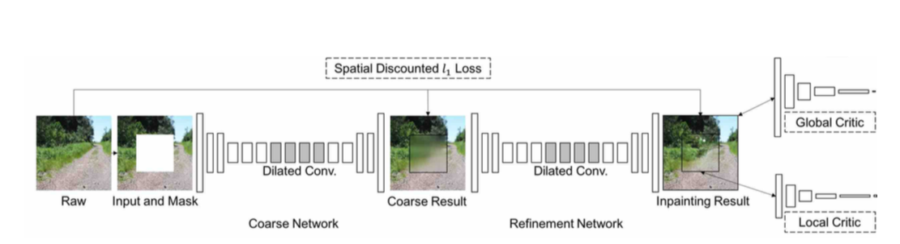
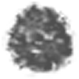
Contextual Attention
Spatially Discounted loss(L1)
Global GAN loss WGAN-GP
reconstruction loss
Local GAN loss
Improvement
Two Networks:
Coarse Network (Reconstruction Loss)
Refinement Network (Reconstruction +GAN)
ELU + Clip Value

Slide 8

Weighted Reconstruction Loss
Mask
p
p’
Weight =
Less ‘hallucination’ for pixels near Boundaries

Slide 9
Contextual Attention Layer
Learns where to Borrow/Copy info from Background
Differentiable, could be trained as deep model.
Shape free the inferencing via Fully Convolution

Slide 10
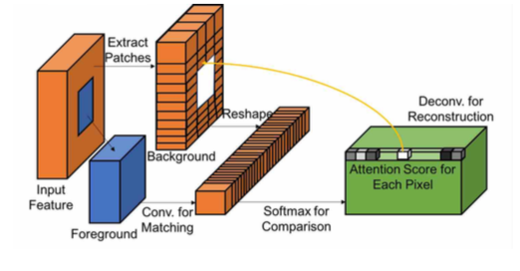
The Architecture
把背景 用 3 x 3 抓patches 出來， 然後一堆 3 x 3 變成filter
把這些filter 與 前景(masked area) 做convolution (size still = 前景, masked area)
做channel wise softmax (with constant)
(注意， 這時候， 每個 前景pixel 值 就是 weight)
* 用 filter 做 deconvolution （意思就是 weight * filter = reconstruct value) (size still = 前景, masked area)

Slide 11
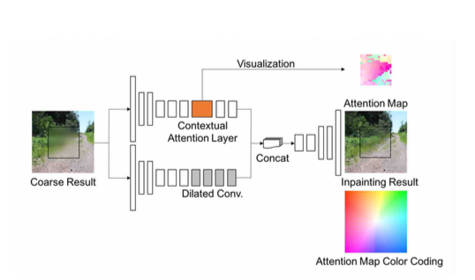
Integrated NN Architecture
Two encoders

Slide 12
Post-thesis Fine Tune
Repeated Inferencing
ReTrain on Food Data
Add on NN (Not completed)

Slide 13
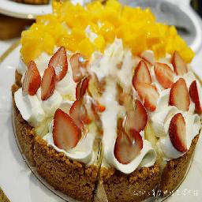
Repetitive Inferencing
1
2
3
4
divide mask into 4 smaller masks
Iteratively send to model for inferencing
1
2
3
4

Slide 14
Review of Failure Samples
背景太複雜
Non_Coherence

Slide 15
睡醒以後的工作
Whole Data Retrain ….(愛心GPU hours 貢獻)
Add on Network: Shape Free SAGAN with Style/Content Loss
革命尚未成功， 阿宅仍須努力

Slide 16
Review

